Slide 1
QUALITY CONTROL OF STEEL TURNING MACHINING PROCESS
Avnish S. Rai
Aditya V. Bagaria
Keerthiraj Dillibabu

Slide 2
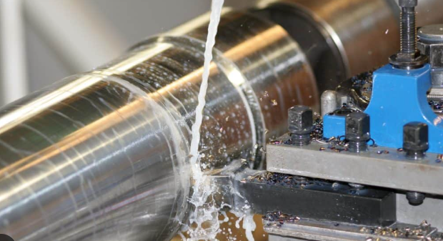
Introduction
Surface roughness is a critical quality factor that affects the performance of components, and its value is highly dependent on the manufacturing process parameters. In the turning process of steel, the surface roughness value varies with different depths of cut, feed rates, and cutting speeds. However, the current surface roughness value of a component does not meet the desired standard, leading to customer complaints and quality issues.
Problem statement: Due to the strong demand for steel, the production process may occasionally require greater output; as a result, the input parameters may be altered, sometimes causing the surface roughness value of the producing steel sheets to fall below the desired standard and leading to quality problems.
The objective of this project is to optimize the input parameters, including feed rate, minimum cutting speed of 50, maximum cutting speed of 250, and depth of cut varying from 0.5 to 2.5, to achieve the desired surface roughness value while maintaining process stability. The project scope includes the analysis of production data using advanced quality control techniques such as statistical process control (SPC), statistical analysis, EWMA, CUSUM, and change-point detection.

Slide 3
Data Structure
The data set here include the roughness of machining process with cutting parameters such feed rate depth of cut (ap), cutting speed (vc), feed rate (f), roughness(Ra).
Data Set :
Currently, dataset have feed rate ranging from 0.5 to 3 mm per sec, and cutting speed from 50 to 250.
Ap | f | Vc | Ra
0.5 | 0.05 | 50 | 3.36
0.5 | 0.05 | 100 | 2.48
0.5 | 0.0 | 150 | 1.52
0.5 | 0.05 | 200 | 1.72
0.5 | 0.05 | 250 | 1.13
0.5 | 0.1 | 50 | 5.03
0.5 | 0.1 | 100 | 2.54
0.5 | 0.1 | 150 | 2.03
0.5 | 0.1 | 200 | 1.93
0.5 | 0.1 | 250 | 1.81
0.5 | 0.15 | 50 | 5.86
0.5 | 0.15 | 100 | 2.58

Slide 4
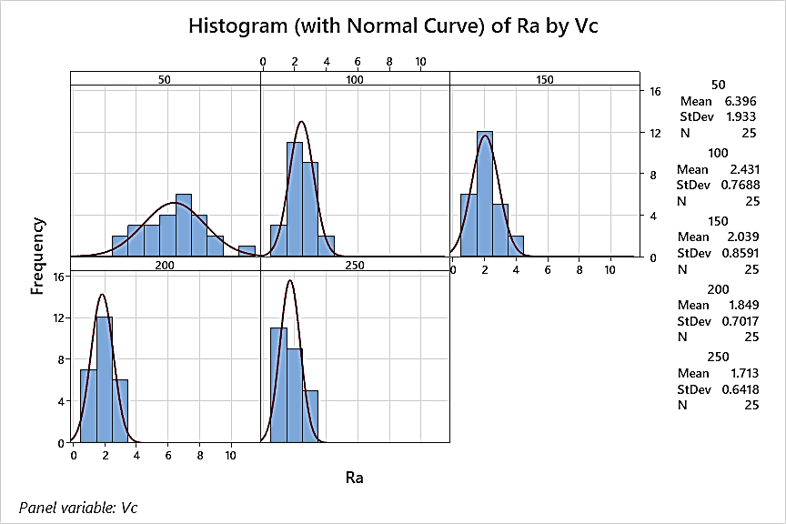
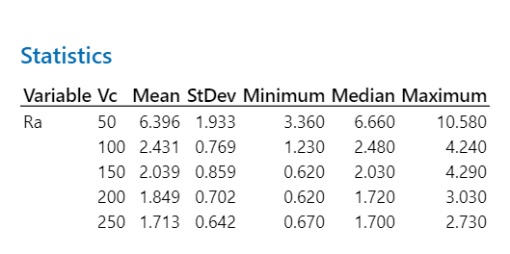
Initial Analysis

Slide 5
ANALYSIS STEPS
DATA COLLECTION.
DATA CLEANING.
DESCRIPTIVE STATISTICS.
SPC- X BAR , R AND S CHART.
REGRESSION ANALYSIS.
T^2 HOTELLING CHART
CHANGE POINT DETECTION – CUSUM EWMA.
SHEWHART CHART
OPTIMIZATION- USING RESULTS.

Slide 6
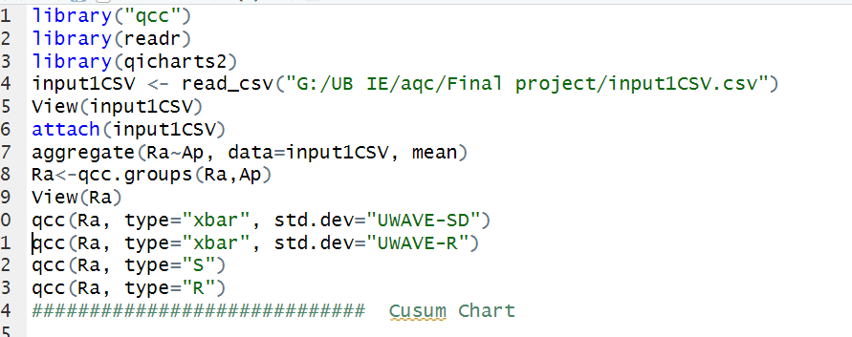
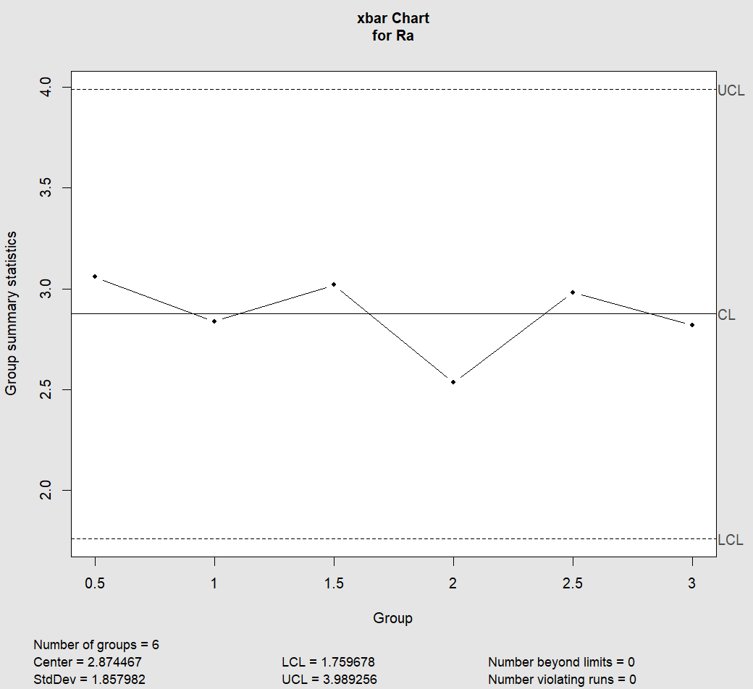
XBAR Chart
Code Output

Slide 7
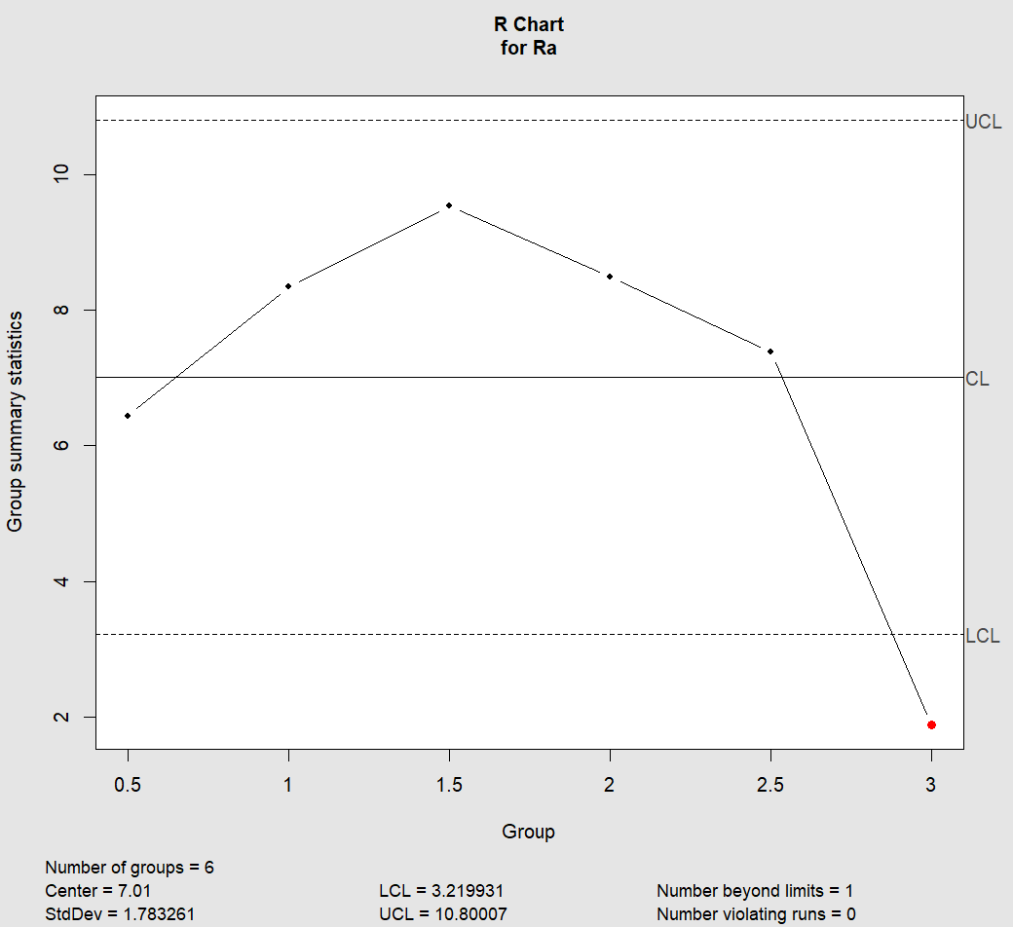
R bar Chart
The range for sample with depth of cut 0.5, 1, 1.5, 2,2.5 is greater enough.
The difference between the maximum and minimum values of the sample data for each depth of cut is relatively large.
This indicates that there is a high variability in the roughness measurements for each depth of cut.

Slide 8
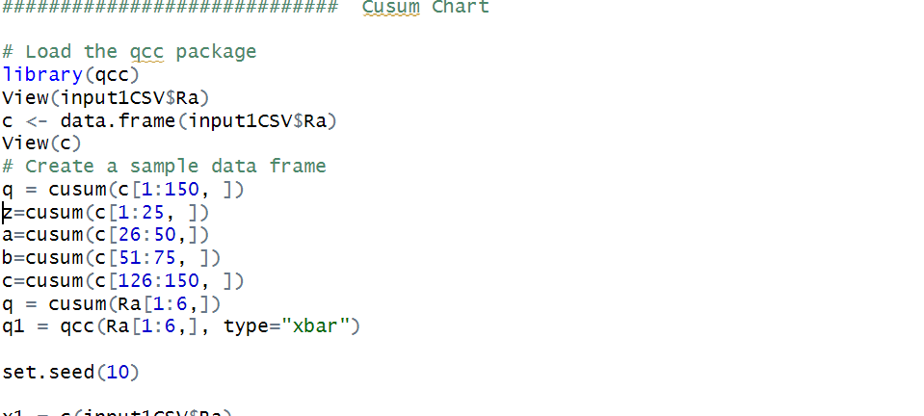
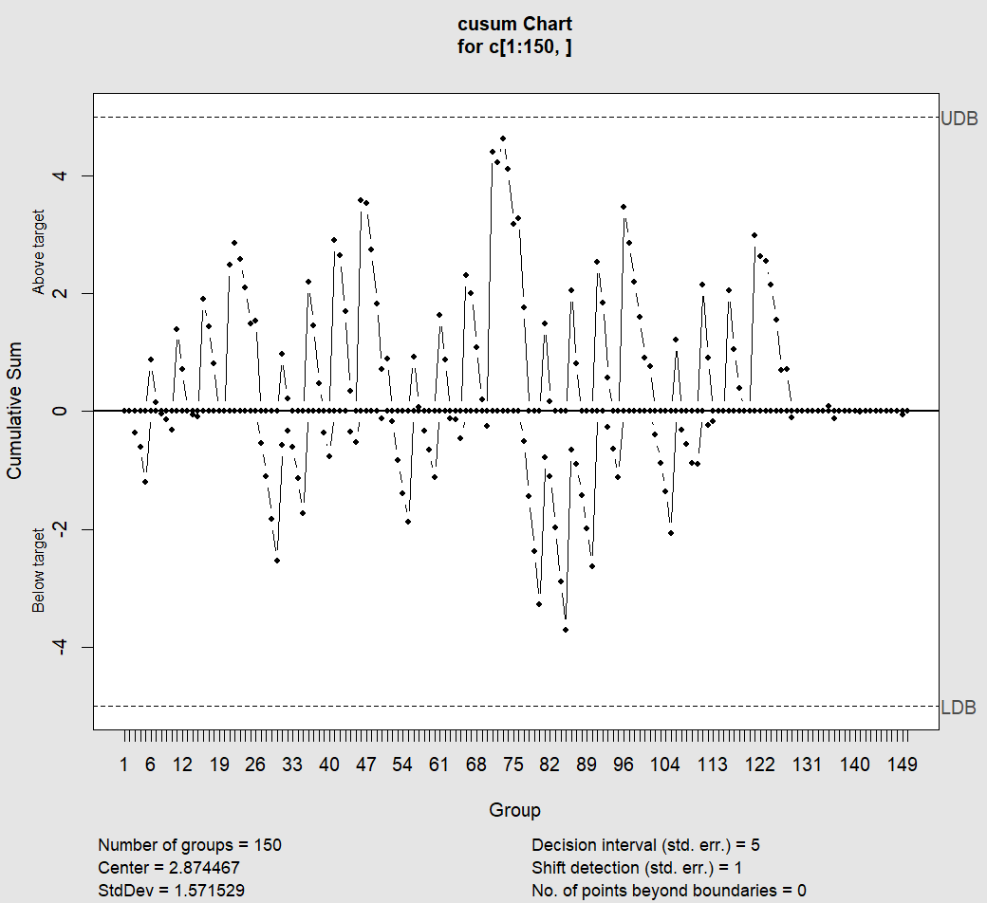
CUSUM Chart
Code Output

Slide 9
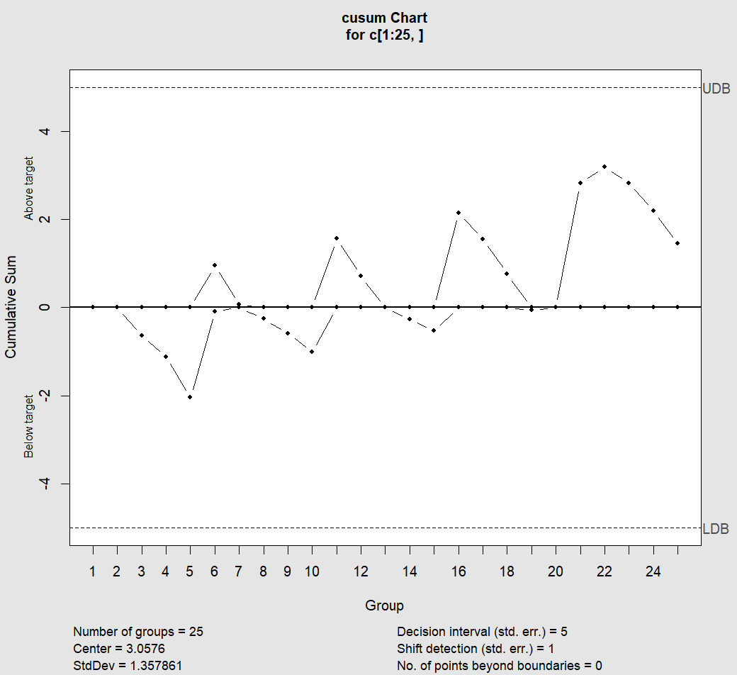


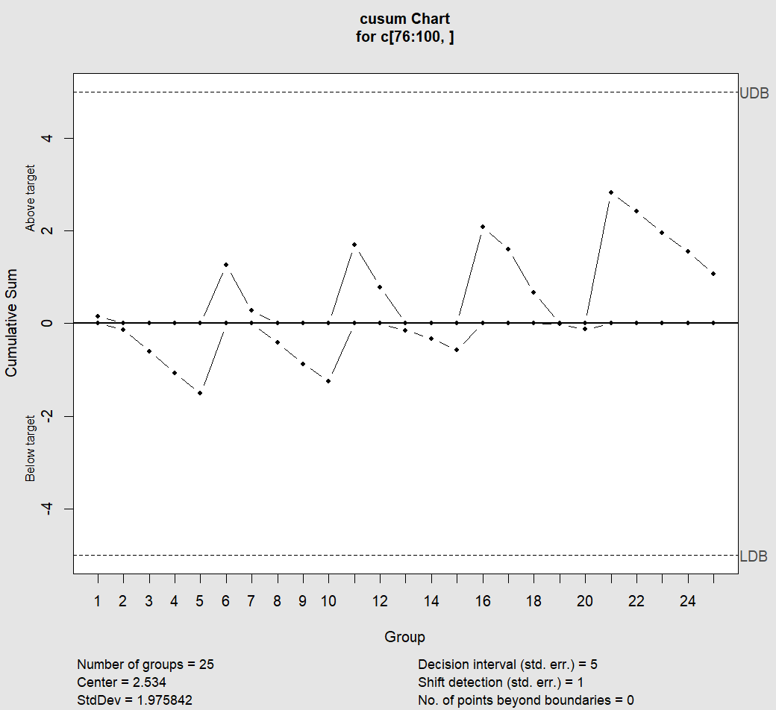

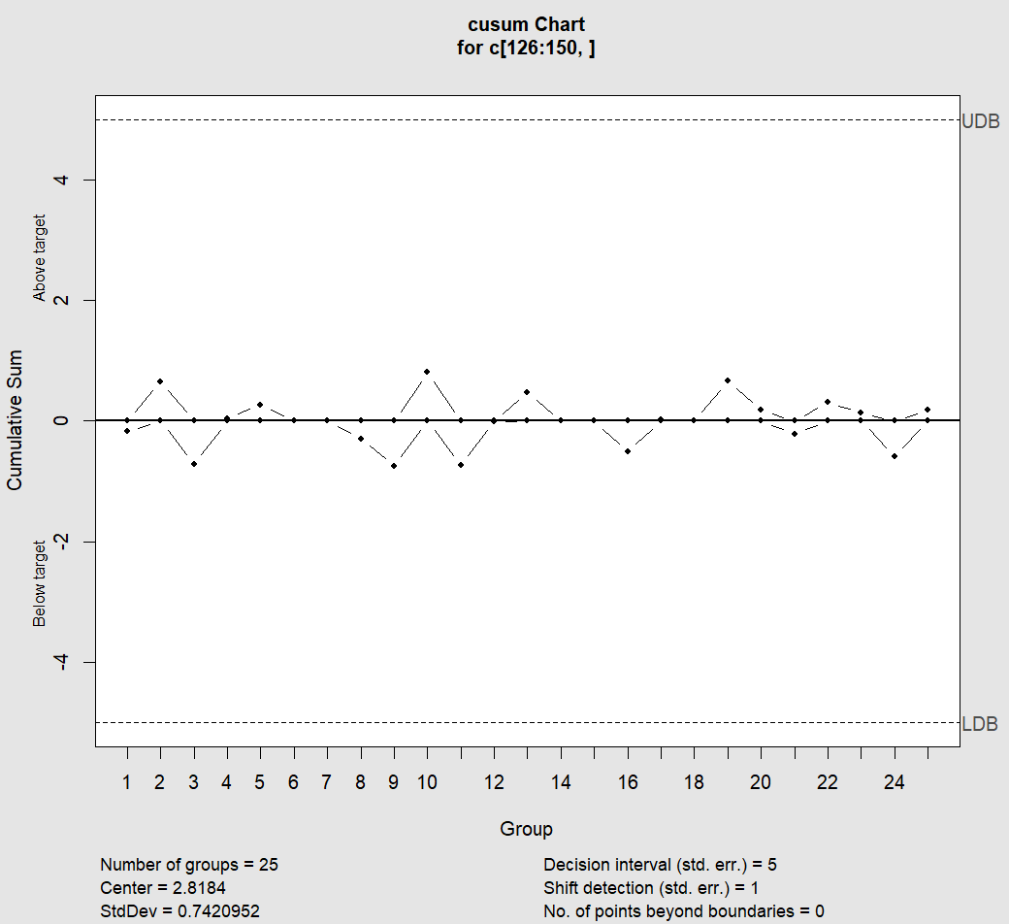
CUSUM For Individual Sample

Slide 10
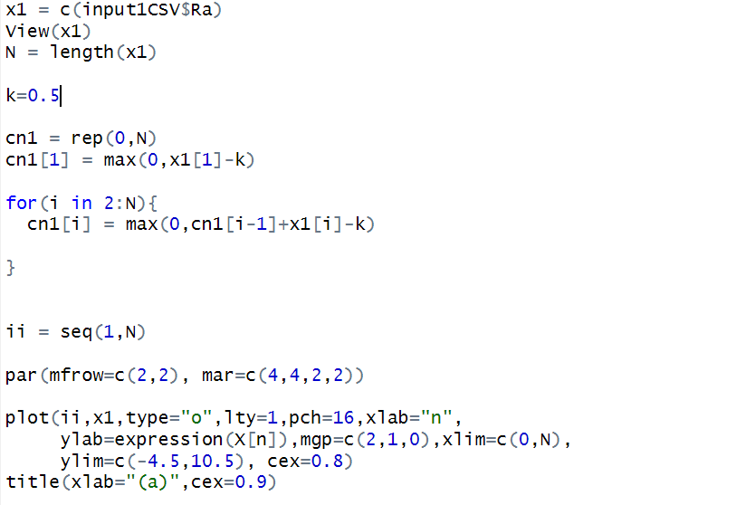
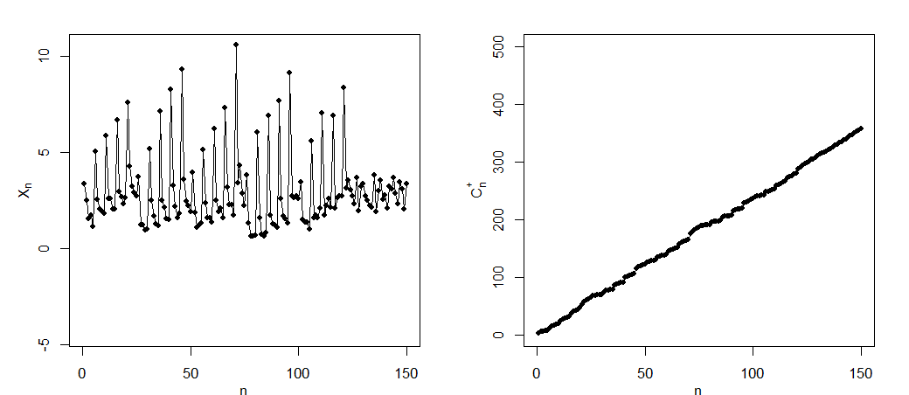
CUSUM(Multivariate)
Code Output

Slide 11
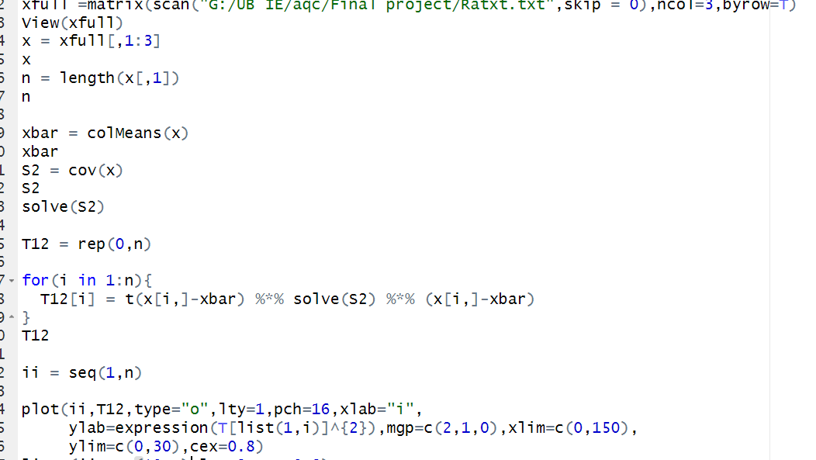
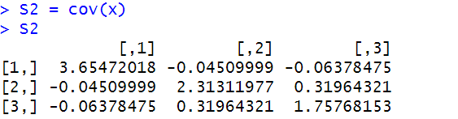
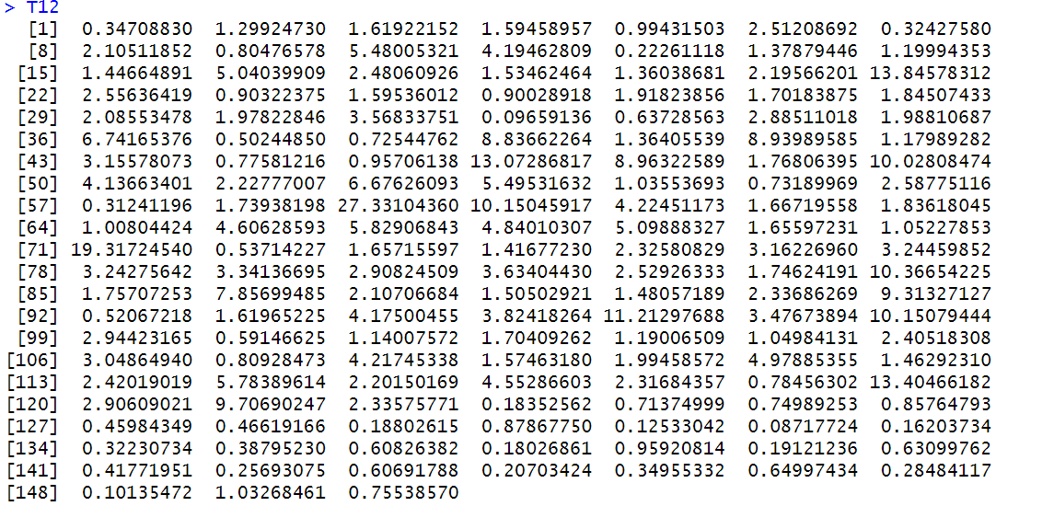
T^2 Hotelling Chart
Code Output

Slide 12
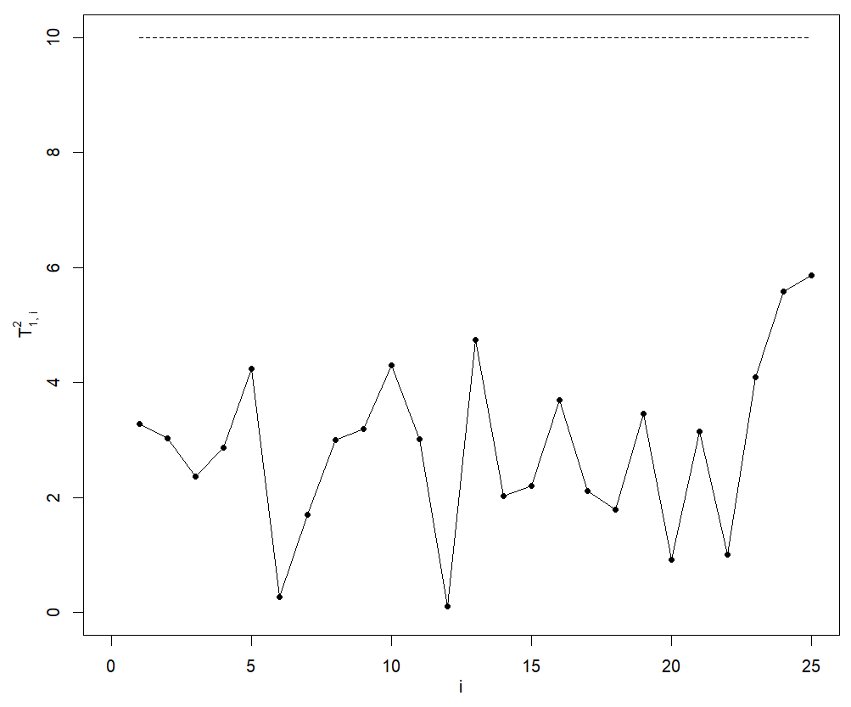
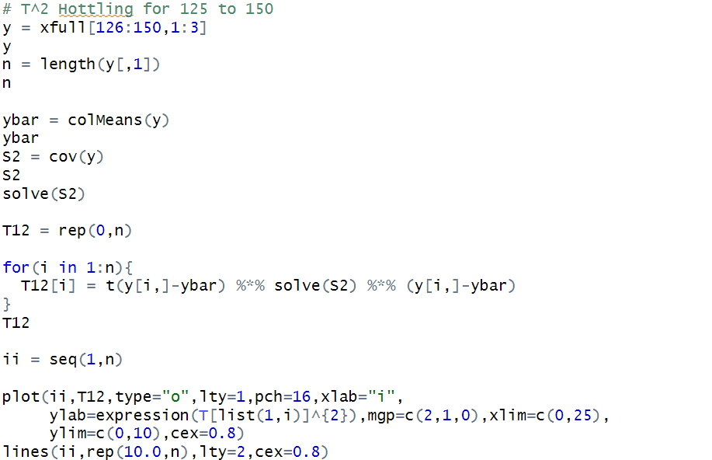
T^2 Hotelling for 126 to 150 Sample Points
Code Output

Slide 13
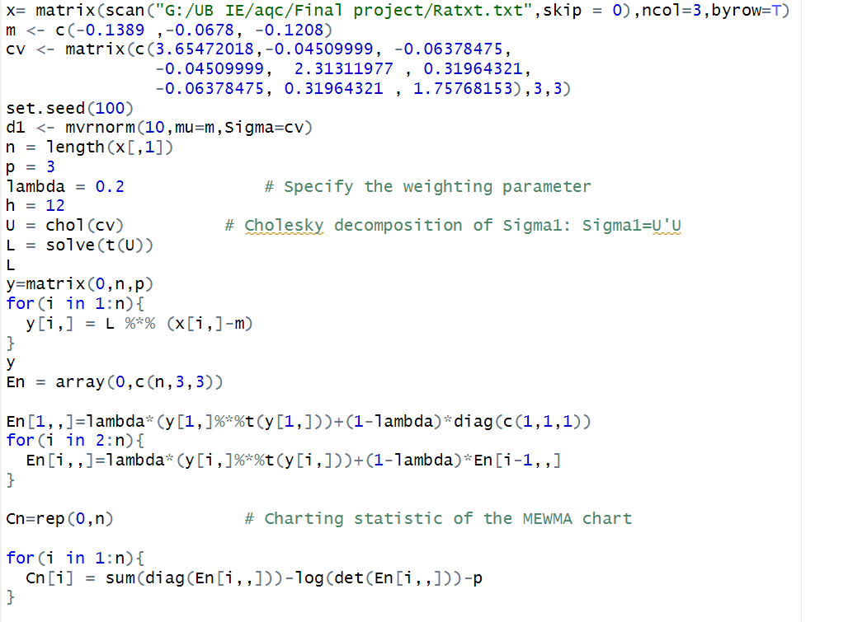
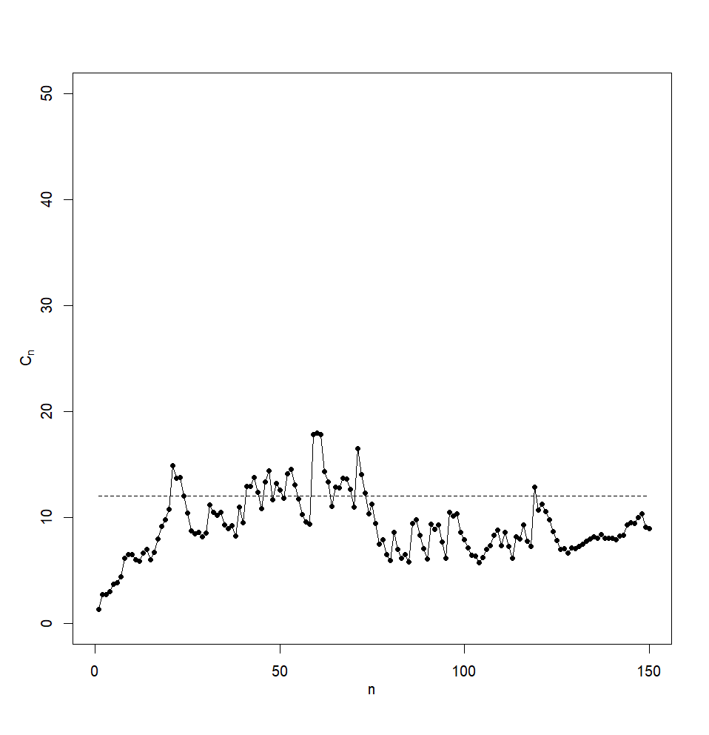
EWMA
Code Output

Slide 14
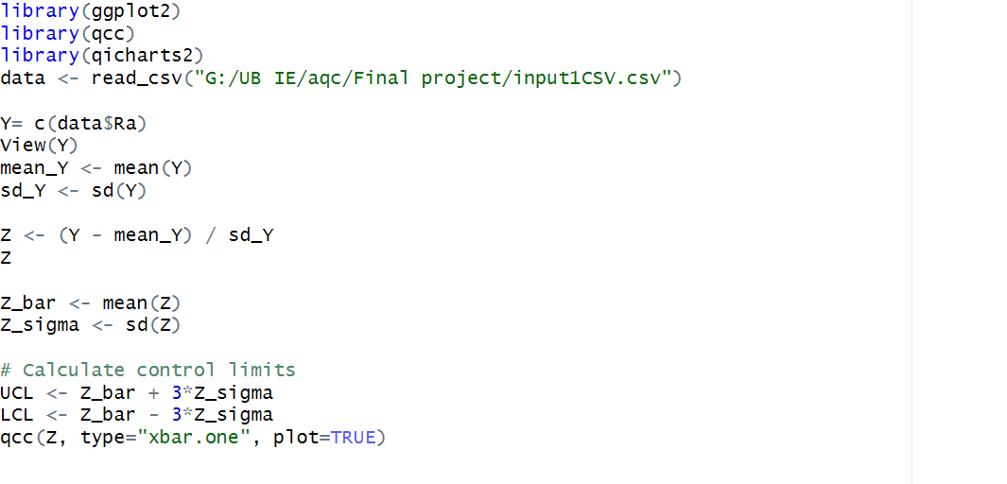
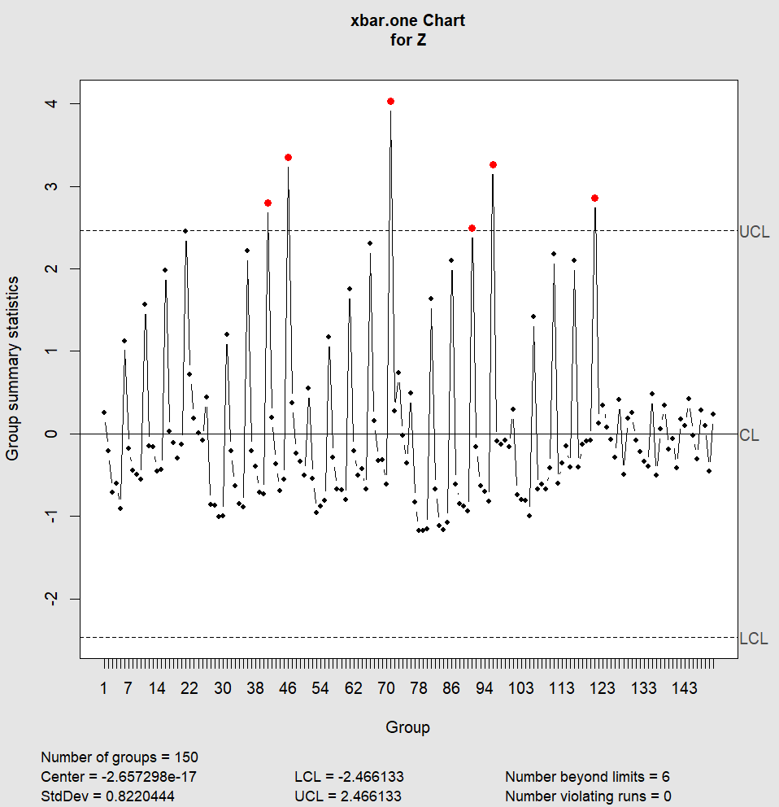
Shewhart Chart

Slide 15
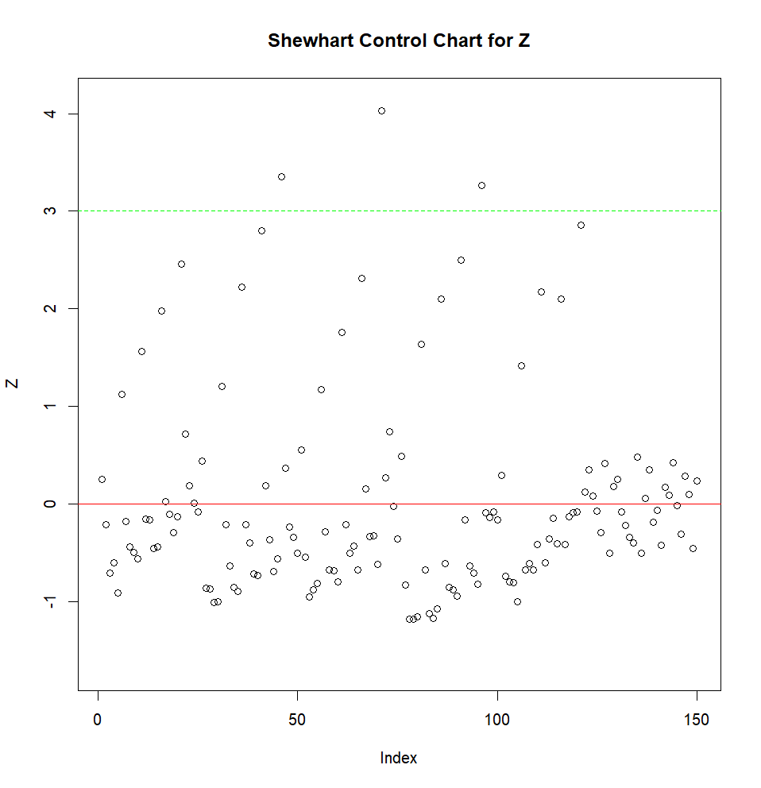
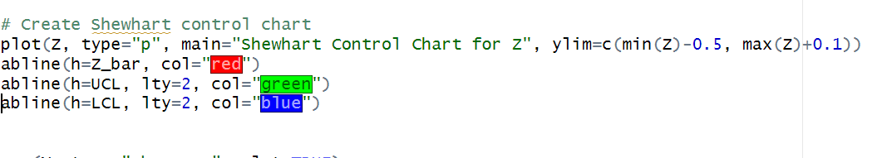
Shewhart Chart

Slide 16
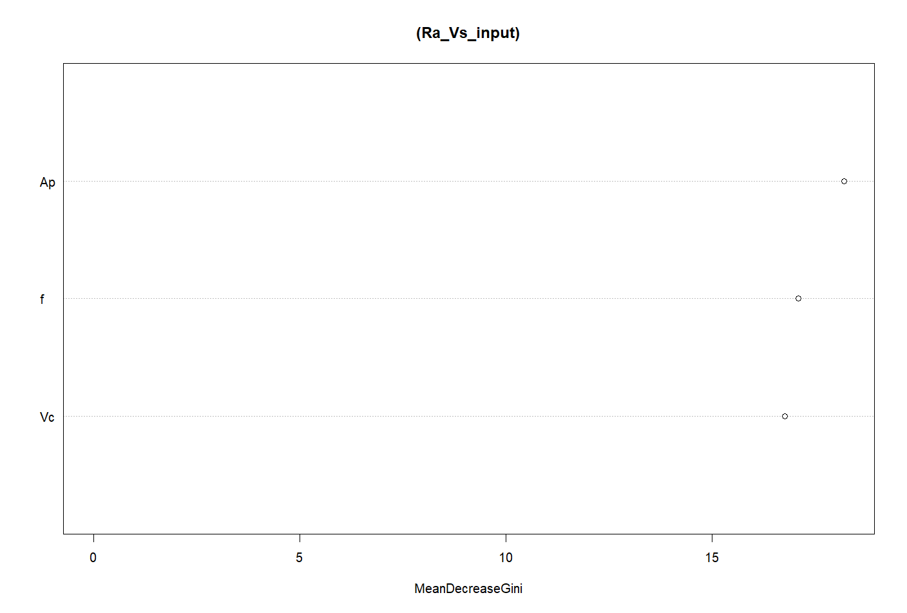
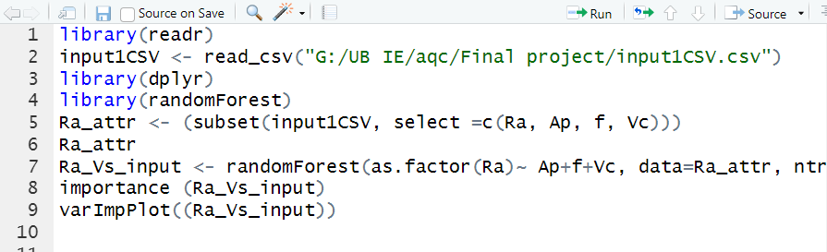
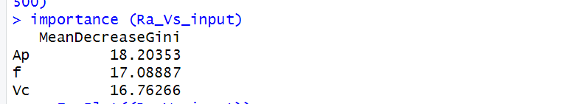
Feature Extraction Using Random Forest

Slide 17
Conclusion:
The surface roughness of the steel was observed to be in control for values 126 to 150.
However, the roughness was out of control for values 1 to 125, with 7 points crossing the upper control limit.
The roughness of the steel was found to be mostly dependent on the cutting parameters, such as depth of cut, feed rate, and cutting speed.
To bring the process in control for the out-of-control values, further measurements and adjustments may be necessary.
The use of statistical process control techniques can help monitor the process and identify when it is out of control, allowing for corrective actions to be taken.

Slide 18
References
https://www.kaggle.com/datasets/adorigueto/cnc-turning-roughness-forces-and-tool-wear
https://www.academia.edu/37002297/ANALYSIS_OF_SURFACE_ROUGHNESS_MILLED_OF_STEEL_AISI_1045_USING_X_BAR_AND_R_CONTROL_CHART
https://journal.r-project.org/archive/2021/RJ-2021-034/RJ-2021-034.pdf

Slide 19
ANY QUESTIONS??

